Slide 1
Overview
(review)

Slide 2

Mission Statement
  "To design and develop Chameleon, an adaptive Integrated Development Environment designed for instructional purposes. The goal of the Chameleon I.D.E. is to provide an environment with which an introductory computer science students can be comfortable in, and also have the ability to adapt with the student as the skill and functionality needs of the student change.”
  Basic concept: an IDE whose features and complexity can be set by the professor
  Targeted at CS 1210/1220 students (ie, students with experience ranging from none to about one year), their prof, and possibly upper-level CS students.

Slide 3
5½ Major Accomplishments

Slide 4
1) Terminal
  Utilizes the third-party wxTerm class
  True SSH connections via Plink
  Status: Done!
2) Compiling
  Not much work required
  “Basic” compiling easily implemented
  Status: Ongoing (“advanced” compiler output left)

Slide 5
3) Terminal scrolling
  Limitations of wxTerm’s design
  Completely replaced the original text management scheme
  Status: 95% done (couple small tweaks to be made)
4) Project management
  Fairly simple management implemented
  Needs some more work, but usable
  Status: Ongoing (debugger integration issues, mostly)

Slide 6
5) Debugger
  Tons of research & coding done
  Basic integration accomplished (last night, actually :) )
  Status: Ongoing (last major feature left)
5 ½.) Everything else
  Lots of bugfixes (stability, usability, and more)
  Reworked process / threading
  Most permissions now implemented (GUI changes, etc)
  Authorization code system revamped
  Large chunks of internal code refactored for better structure

Slide 7
Status

Slide 8
GUI – 85-ish% complete
  “Turn it off, it disappears” works
  Terminal works – big success
Editor - 85% complete
  Really not changed that much
  Mostly cleaned stuff up, added some debugger-related items
Networking - 85% complete
  Re-Organization is in progress
  All Asynchronous to remove sluggish-ness

Slide 9
Compiler - 50% complete
  Relatively little to do
  Some “win32 shell stinks” issues
Permissions – 99.9999% complete
  Adapted Authorization code to CRC
  Any other changes purely cosmetic
Debugger - 70% complete
  3 almost full re-designs
  Heavy code re-factoring
  Integrated to Chameleon, working on a basic level

Slide 10
Status
Risks

Slide 11
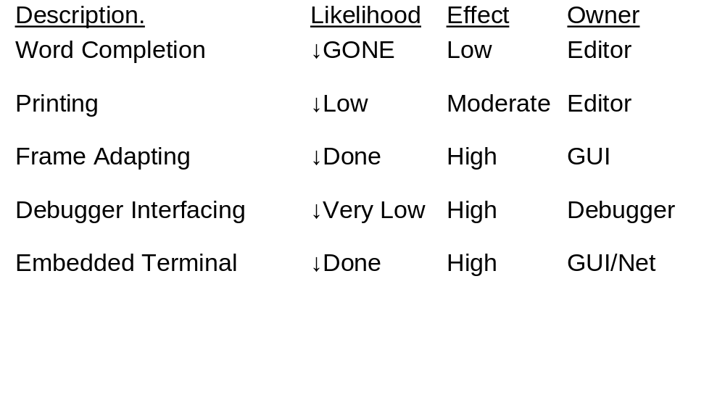

Slide 12
Status
What’s Left

Slide 13
Debugger
  Variable snooping / setting / watching
  Perfection of remote based debugging
User Manual
  Update based on new functionality; finish tutorial
Smaller tasks
  Find/replace
  Syntax highlighting customization
  Password encryption
  Whatever else we can think of

Slide 14
Demo Time!

Slide 15
Summary Comments...
Overall health of the project
Any project-wide issues?
What have you learned (teamwork, management, planning, coordinating, etc.)?

Slide 16

Questions

